Slide 1

Department of First Year Engineering
title :focus: to do list
Name of faculty : Prachi karale
52 Ahint Sonawane 9422022053
42 Anurag Agarwal 6297196566
38 Durgesh Katigar 8355961676
62 Nishant Surve 9665268298
48 Nishant Sadare 8080094328
39 Shreyash Drakshe 7020404831

Slide 2
Aim :-
To do list application (App) is used for organisation our tasks of the day in a list . In this application we can create a list of task that you need to complete, the list of task will be there along with date .We can also add a little to that task and then add the related notes to it and we can also delete or edit the list .By using this application specially students can gain discipline and get productive.
OBJECTIVES
1. To organise the tasks of the day in a list format.
2.For increasing the productivity by giving priority to the task or thins of the day.
3.To use time wisely and stopping from forgetting things.
4.To help specially (student) for improving there time management as well as work flow
to reduce stress and to maintain proper discipline.

Slide 3
BLOCK DIAGRAM
STRATEGY
Define Strategic goals for evolving your idea into successful app.
UI\UX Design
Create seamless and effortless experience
With polished design.
TESTING
Validate your app’s quality thoroughly with a series of testing criteria
ANALYSIS AND PLANNING
Identify requirements and prepare raodmap
APP DEVELOPMENT
Develop back-end, API and mobile app.

Slide 4
Project Explanation
To do list android /app is used for organising the daily tasks mainly in a list format. In this app user will be adding their daily tasks and one by one clicking to the add icon and the format of input is title and the notes related to it ,to delete and update the tasks we have to use gesture command as after completion of task to delete it swipe right it will get deleted and to update the task swipe right left on screen and add requirement note to it ,by using this app it will help . To organise our important tasks in a list format ,so it is easy to keep a track on day especially students . This app will help to keep students to focus on tour on their daily schedule.

Slide 5
Software development
To build the to do list app we have used Android Studio our app is completely build by using the Java language and concepts of oops (polymorphism , interfaces, construction ,abstraction).The layout of screens (intro screen )background images and icons like (card view ,toolbars plus icon )XML is used to make interactive pages and data base and that used in Room database ,by using room database we build CRUD application(create ,read ,update ,delete) and MVVM Architecture is used to organise code and breaks programs into modules to make development as it is separate he control logic form UI(usre interface )and data structure.

Slide 6


Photographs of the project

Slide 7
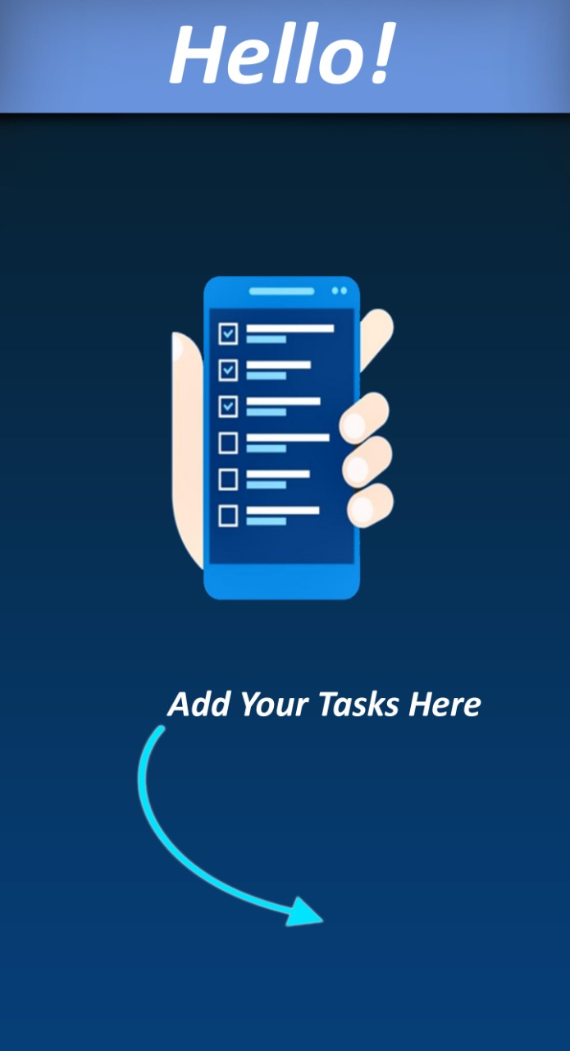
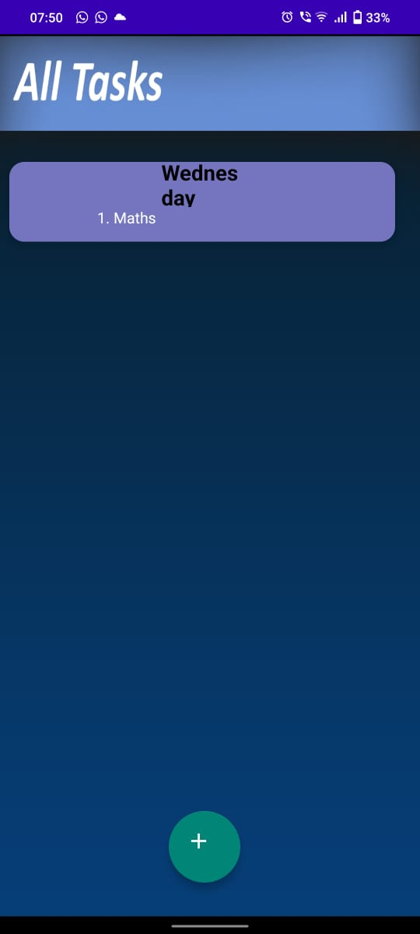
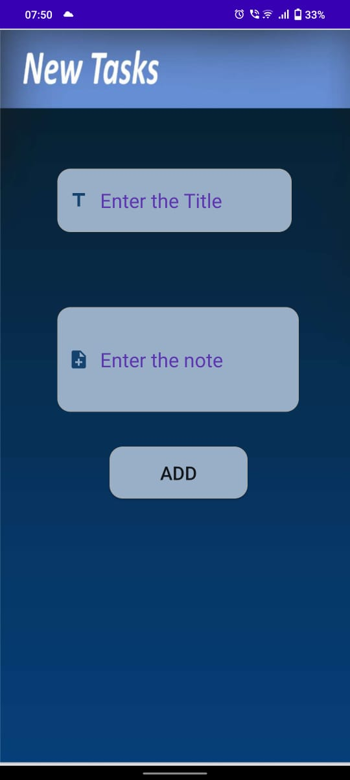
Workflow of app:-

Slide 8
Conclusion and Future scope
From to do list application we can conclude that a student or a person who is not focused in his work can gain success by using this application.
To do list is a good option for using for your academics and daily schedules.
Future scope of this application is that to bring a scheduled or a disciplined life this app is a better option for those who are not doing well.
Future scope of this app will increase immensely due to it’s nature of task management.

